Slide 1

WELCOME
EXPOSYS DATA LABS
conclusion
introduction
research
result analysis
DATA SCIENCE
INTERNSHIP PROJECT
Submitted by:
Twinkle Paul
Data Lab Intern
Exposys Data Labs

Slide 2
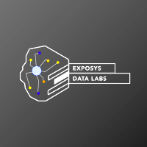

conclusion
research
introduction
result analysis
Problem Statement:
Customer Segmentation Using K-Means Clustering
Knowing who your customers is great, but knowing how they behave is even better.
-Jon Miller
Details.
Skip

Slide 3
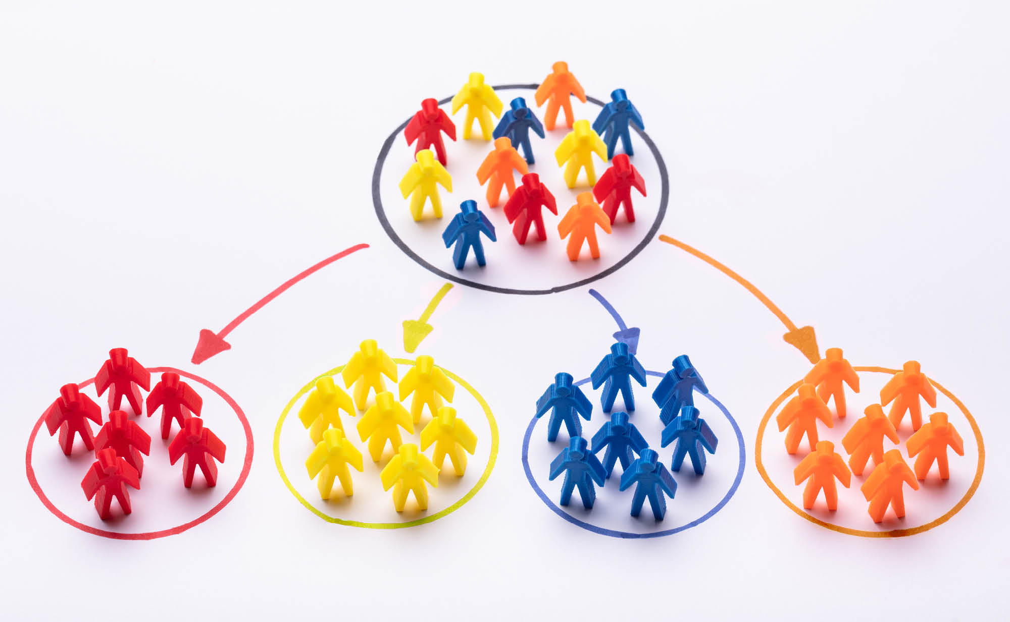
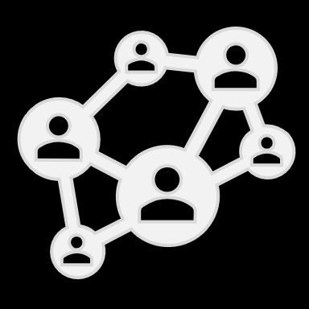

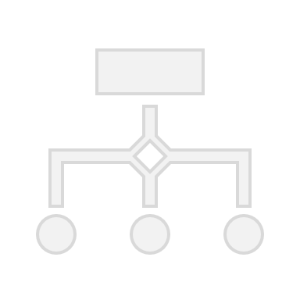

Customer Segmentation:
intro
Customer Segmentation (also known as market segmentation) is the division of potential customers in a given market into discrete groups.
WHAT?
Division is based on customers having similar enough:
Needs, and Buying characteristics.
BASIS
Isolates the market into individual categories making marketing campaigns more precise to direct focus on serving smaller, more refined segments.
WHY:

Slide 4





Approach Taken:
Survey
Solution
Process
1
2
3
research
conclusion
introduction
result analysis
Existing
Methods:
Proposed
Methodology:
Implementation
Describes the commonly used Customer Segmentation Methods.
Describes Chosen Segmentation Method.
Describes the Steps Involved in Segmentation.
Details.
Skip

Slide 5

survey
research
Existing Methods:
1
Demographic Segmentation
- focused entirely on traits of customer – gender, age, marital status, occupation, stable income, etc.
Geographic Segmentation
2
- effectively splits entire audience based on location (region, continent, country, city, and district).
3
Psychographic Segmentation
- differentiates customers based on their personalities (lifestyle, attitudes, interests, and values).

Slide 6
survey
research
Existing Methods:
4
Behavioral Segmentation
- uses classification scheme based on previous behavior that customers have exhibited with the brand like
product knowledge, purchase patterns, previous purchases, awareness of the business, and product rating.
Industry - Based segmentation
5
- Segments industrial consumers on characteristics such as location, company type and buying characteristics.

Slide 7



solution
research
Proposed Methodology:
What?
Why?
How?
Demographic & Behavioural Segmentation
Combined Segmentation Benefits:
By K-Means Clustering algorithm.
Demographic: a market segmentation method based on variables such as age, gender, income, etc.
Behavioural: sorts & groups consumers based on the behaviors they exhibit.
Data uncomplicated and easy to use.
identifies target market by refining marketing style to suit audience type & peak business time.
yields high conversation rates, boost sales, and earth greater profits.
Clustering: exploratory data analysis method.
K - Means is an iterative clustering algorithm.
identifies subgroups(cluster) of customers with similar demographic pattern for market segmentation.

Slide 8
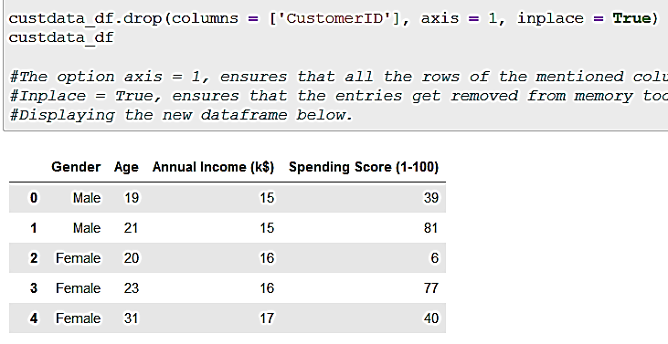



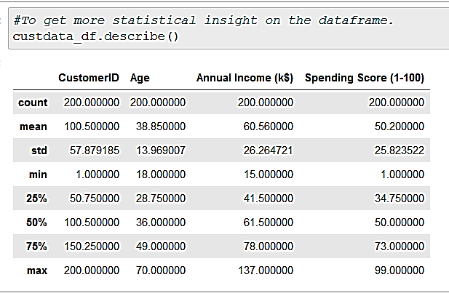

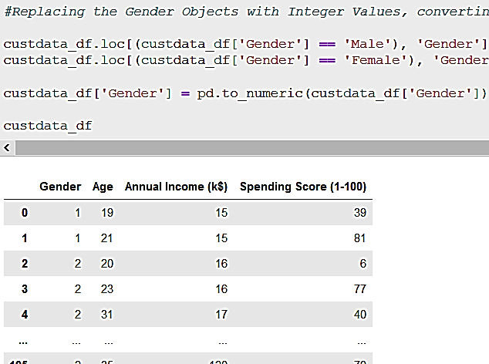
process
research
Steps Involved:
Load & Explore the data
Pre-Process Data.
https://drive.google.com/file/d/19BOhwz52NUY3dg8XErVYglctpr5sjTy4/view
Collect Required Dataset.
Clean Data

Slide 9

Collected Dataset:
 | CustomerID | Age | Annual Income (k$) | Spending Score (1-100)
count | 200.000000 | 200.000000 | 200.000000 | 200.000000
mean | 100.500000 | 38.850000 | 60.560000 | 50.200000
std | 57.879185 | 13.969007 | 26.264721 | 25.823522
min | 1.000000 | 18.000000 | 15.000000 | 1.000000
25% | 50.750000 | 28.750000 | 41.500000 | 34.750000
50% | 100.500000 | 36.000000 | 61.500000 | 50.000000
75% | 150.250000 | 49.000000 | 78.000000 | 73.000000
max | 200.000000 | 70.000000 | 137.000000 | 99.000000

Slide 10

Cleaned Dataset:
 | Gender | Age | Annual Income (k$) | Spending Score (1-100)
0 | Male | 19 | 15 | 39
1 | Male | 21 | 15 | 81
2 | Female | 20 | 16 | 6
3 | Female | 23 | 16 | 77
4 | Female | 31 | 17 | 40
... | ... | ... | ... | ...
195 | Female | 35 | 120 | 79
196 | Female | 45 | 126 | 28
197 | Male | 32 | 126 | 74
198 | Male | 32 | 137 | 18
199 | Male | 30 | 137 | 83

Slide 11

Pre-processed Dataset:
 | Gender | Age | Annual Income (k$) | Spending Score (1-100)
0 | 1 | 19 | 15 | 39
1 | 1 | 21 | 15 | 81
2 | 2 | 20 | 16 | 6
3 | 2 | 23 | 16 | 77
4 | 2 | 31 | 17 | 40
... | ... | ... | ... | ...
195 | 2 | 35 | 120 | 79
196 | 2 | 45 | 126 | 28
197 | 1 | 32 | 126 | 74
198 | 1 | 32 | 137 | 18
199 | 1 | 30 | 137 | 83

Slide 12
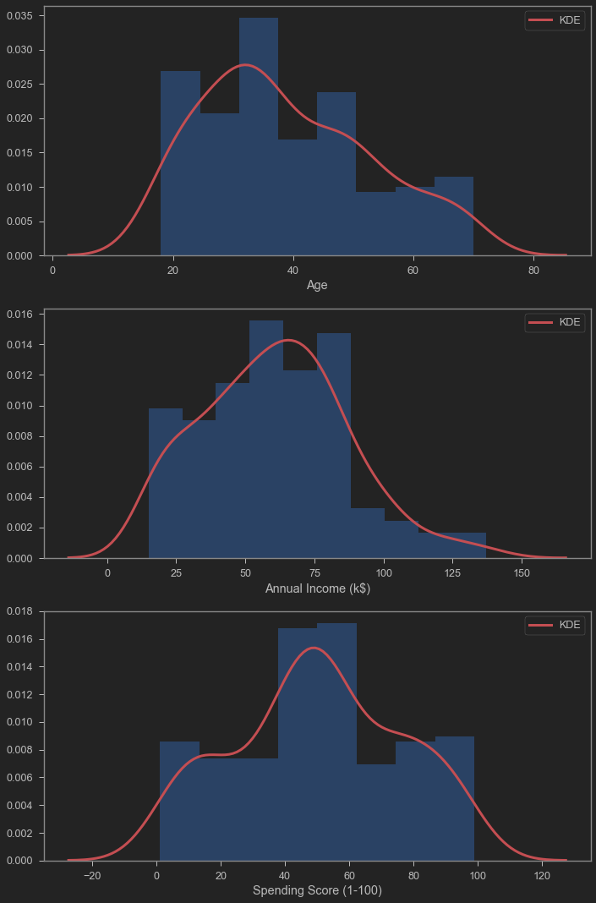
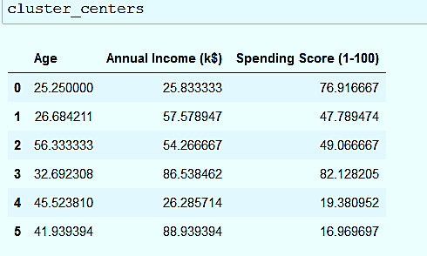
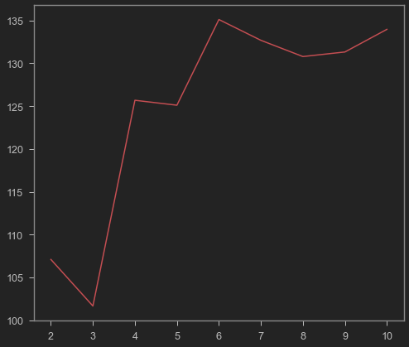
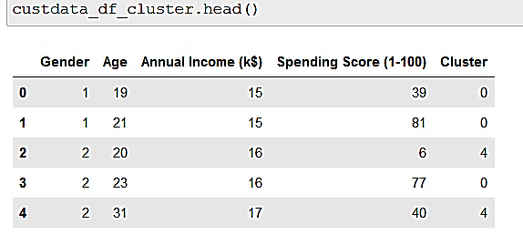

process
research
Steps Involved:
Find optimal no. of Market Clusters.
Fit Data into Model.
Visualize Dataset.
Train Model by K-Means

Slide 13
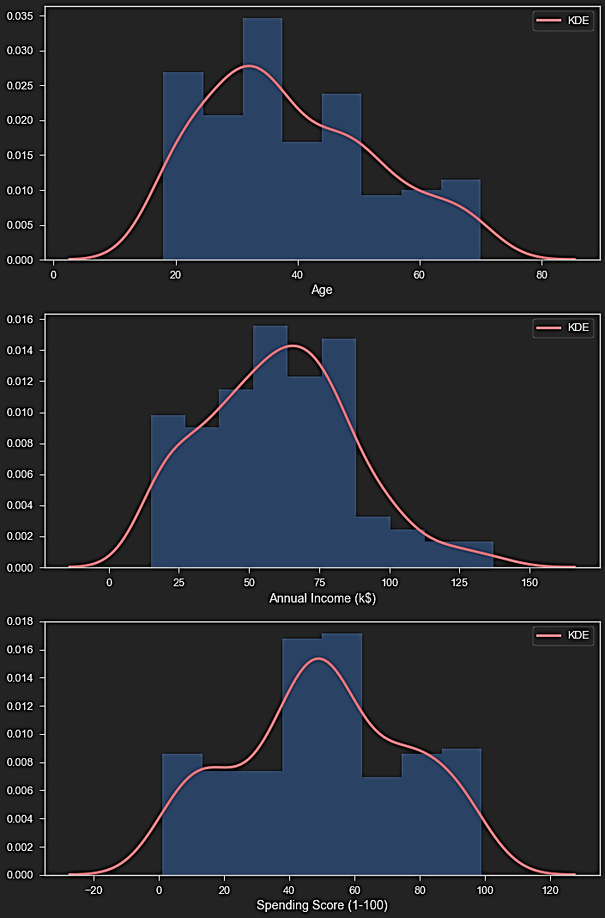
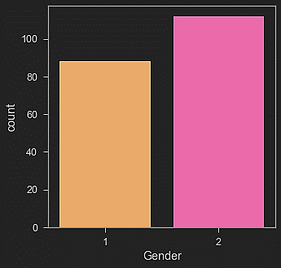
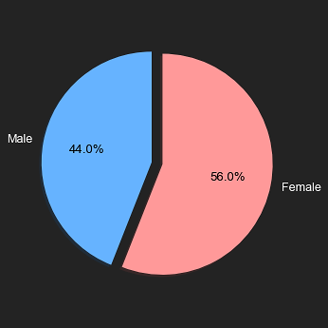
Visualizing Dataset:

Slide 14

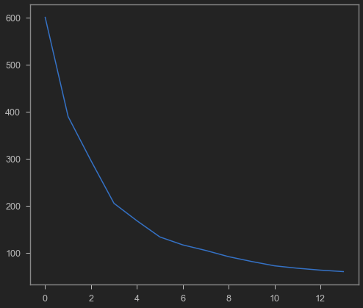
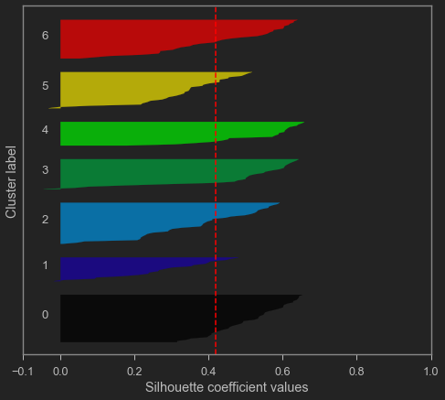
Optimal Clusters:
Silhouette Analysis: k = 6
Elbow Method: k = 5

Slide 15
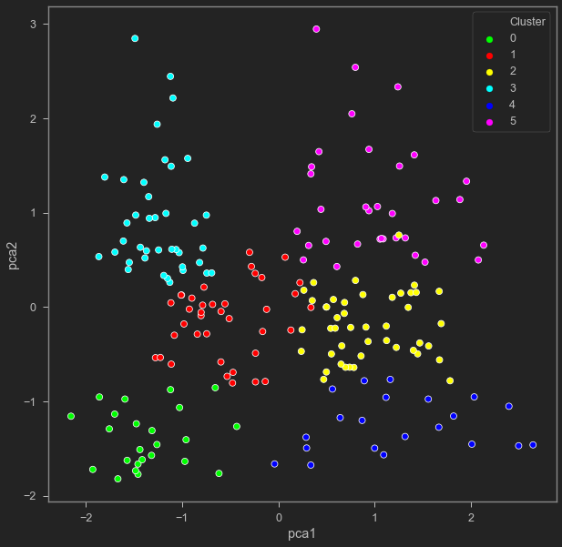
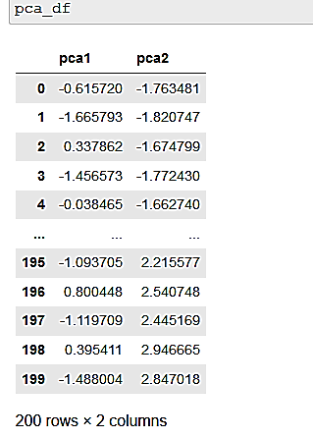
process
research
Steps Involved:
Dimensionality Reduction using Principal Component Analysis.
Determine the Customer Clusters

Slide 16
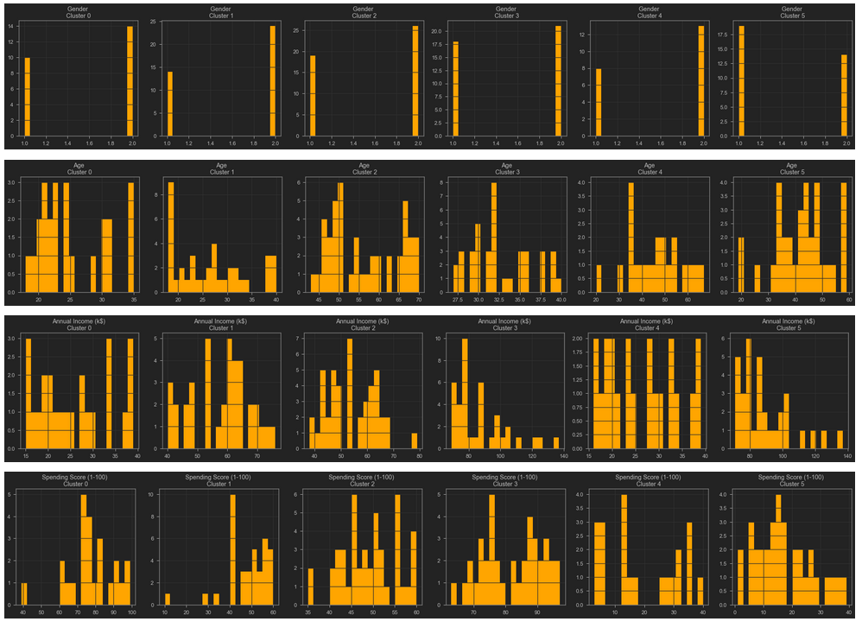

Analysing the Clusters:
Young Moderate Spenders
Middle-aged Moderate Spenders
Young Spendthrifts
Middle-aged, High Earner, Low Spenders
Prime Customers
Low Budget Methodical Customers
conclusion
introduction
result analysis
research

Slide 17
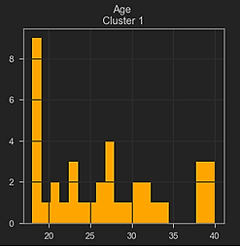
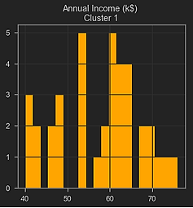
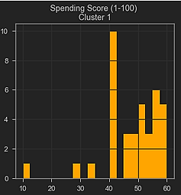
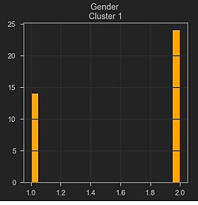
Young Moderate Spenders
result
analysis
young individuals (around 20 - 40); includes teenagers.
female shoppers (approx. 12 units) more than male.
annual income, is quite diverse, range from 40k to beyond 70k, with majority within 55-70k.
spending score, quite low, majority customers lying in the zone of 40 - 60.
Clearly, these customers can be made to shop more. Keeping in mind their low age, they can be targeted towards impulse buying of products needed by the young generation.

Slide 18
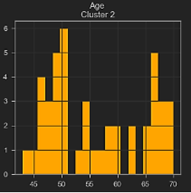
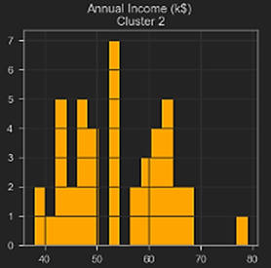
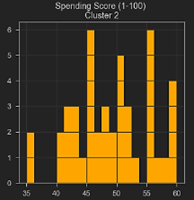
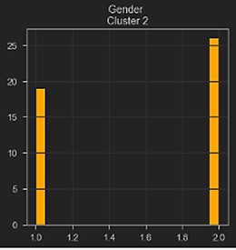
Middle-aged Moderate Spenders
result
analysis
Age mostly around mid-40s to early 70s.
female shoppers (approx. 9 units) more than male.
Annual income range approximately 40-70k; spectacular high frequency of 55k and some exceptions.
mediocre spending score, notable highs in the range of 45 - 60.
These group of customers are careful spenders, and are probably people with family.
individuals with stable income.

Slide 19
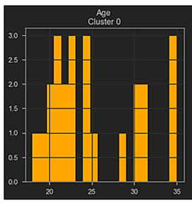
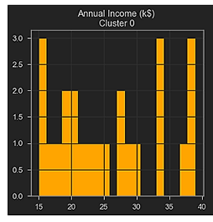
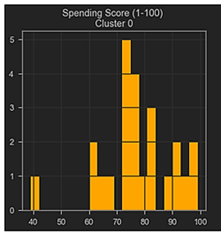
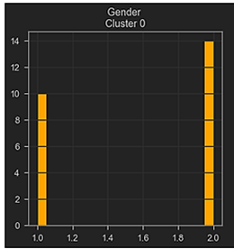
Young Spendthrifts
result
analysis
customers mostly in their early adulthood (around 20 -35).
Not a lot of difference between the male and female customers.
annual income below average annual income of the dataset (<40k)
probably includes college goers, people with new jobs, or promotions.
spending score quite high (mostly, above 50).
A significant amount of them are teenagers.
annual income vs spending score ratio implies impulse buyers.
mall must target this group to bring in more customers.
an asset to the mall who can be expected to buy costlier products in the future.

Slide 20
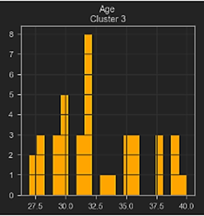
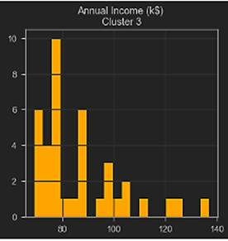
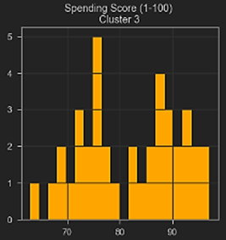
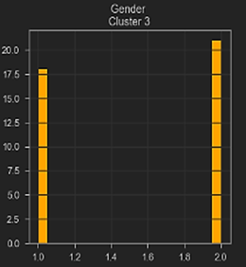
Prime Customers
result
analysis
customers are in mid-age i.e. late twenties to early forties.
are almost evenly distributed gender-wise(only, a negligible 2.5 units more male than female).
annual income significantly high (mostly above 70k).
spending scores distinctly high (above 60).
These are the prime customers of the mall that bring in most of the revenue.

Slide 21
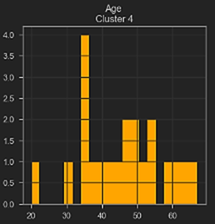
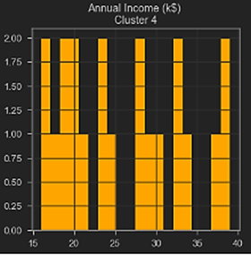
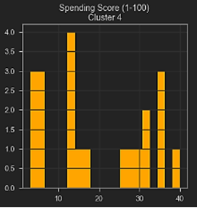
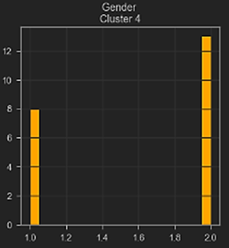
Low Budget Methodical Customers
result
analysis
customers belong to diverse age, though, a notable high can be noted in the region of mid-thirties.
more females than male customers (about 5 units).
customers have low annual income (below 40k)
spending scores are also low spending score (below 40).
Hence, these are the customers with low - budget and methodical purchasing behaviour.

Slide 22
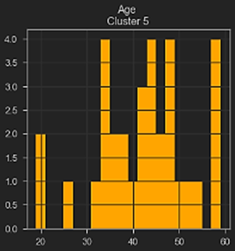
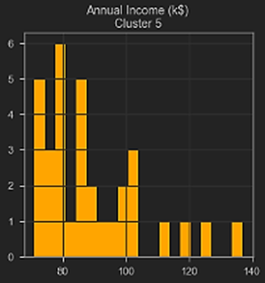
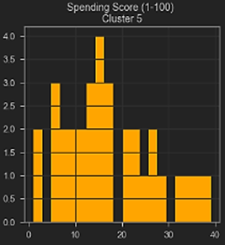
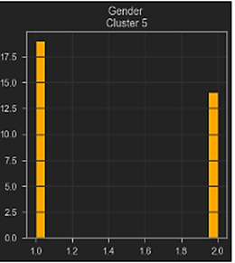
Middle-aged, High Earner, Low Spenders
result
analysis
customers are in the diverse age-group, most in their late thirties to late fifties.
only group with more male (3.5 units more) than female customers.
annual income is the highest (above 70k) among all other groups.
spending score is quite low (below 40).
They probably prefer some other mall or are new customers.
These customers are definitely the worthy target of a marketing campaign.

Slide 23
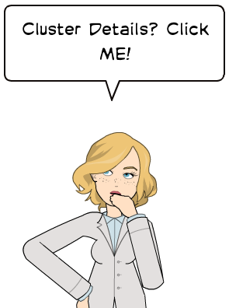
Conclusion:
Using K-Means Clustering on a dataset containing demographic and behavioural variables, yields us 6 different segments of customers.
Mall can re - use the trained model generated in this project,.
Each Customer Segment has its own characteristics, and its own distinct marketing needs.
The Model can be used to allocate unknown customers or data points to the relevant segment.
This would enable to understand the customer’s specific needs and target them with a marketing technique that has been tailored to that individual.
This would in turn, increase the mall’s share of profits.
conclusion
introduction
research
result analysis
End

Slide 24


conclusion
Young Spendthrifts: negative pca1 and negative pca2 value
Young Moderate Spenders: both pca1 nad pca2 value in range of -1 to +1
Middle-aged Moderate Spenders: positive pca1 and pca2 value in range of -1 to +1.
Prime Customers: negative pca1 and positive pca2 value.
Low Budget Methodical Customers: positive pca1 and negative pca2 .
Middle-aged, High Earner, Low Spender: with positive pca1 and positive pca2.

Slide 25
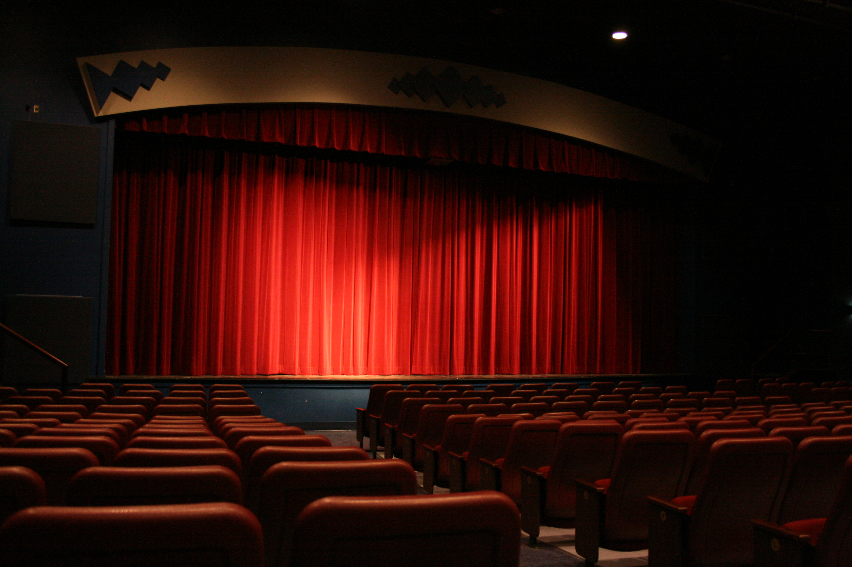

THE END

